Slide 1


GlasGO
Level 2 Student Project
Web Application Development 2
School of Computing Science
2020/2021

Slide 2


Slide 3




Development Tech
Python
Django
HTML
CSS
Bootstrap
Ajax
JQuery

Slide 4
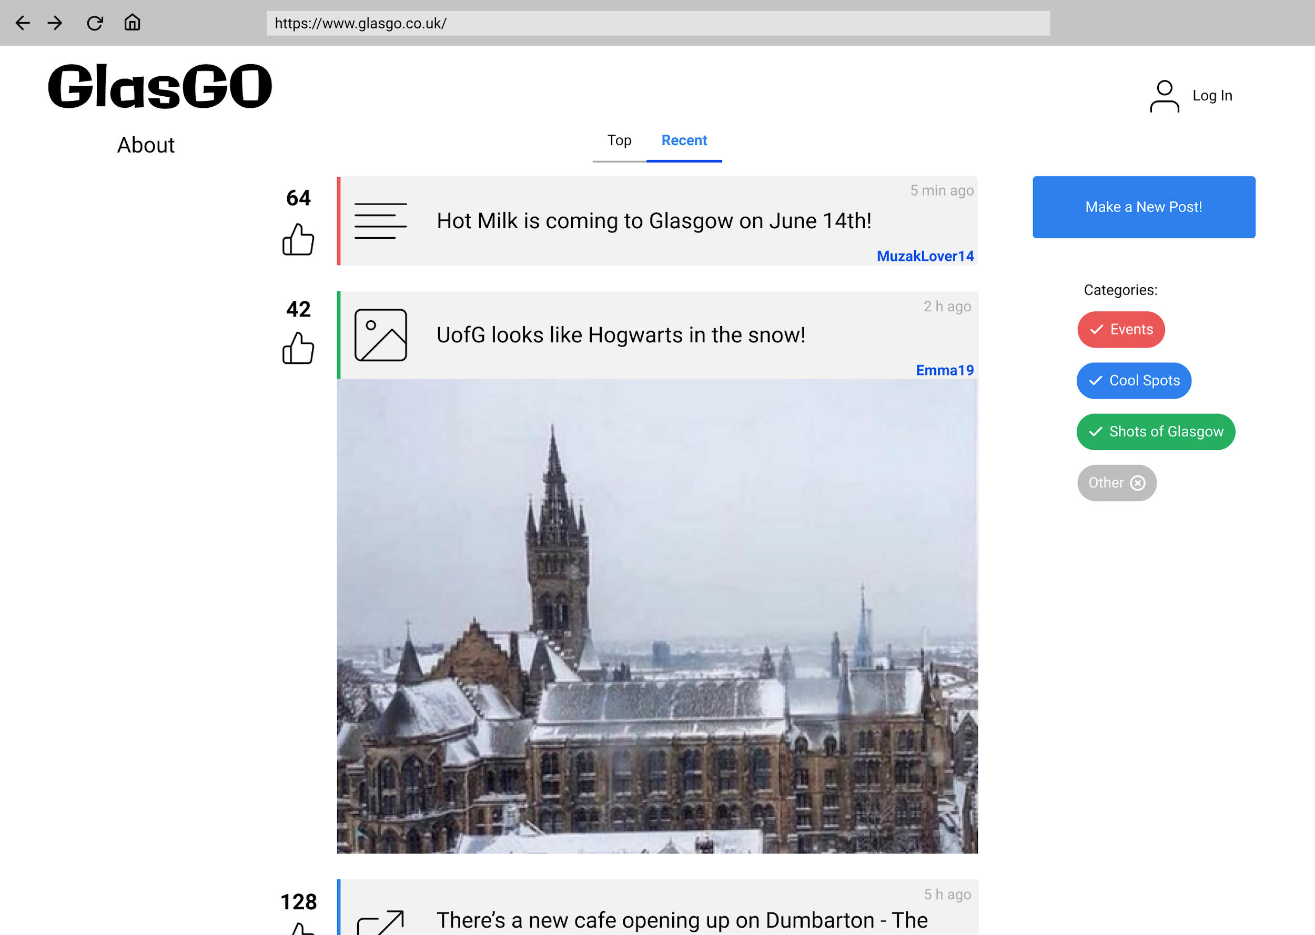
Wireframes – Index Page

Slide 5
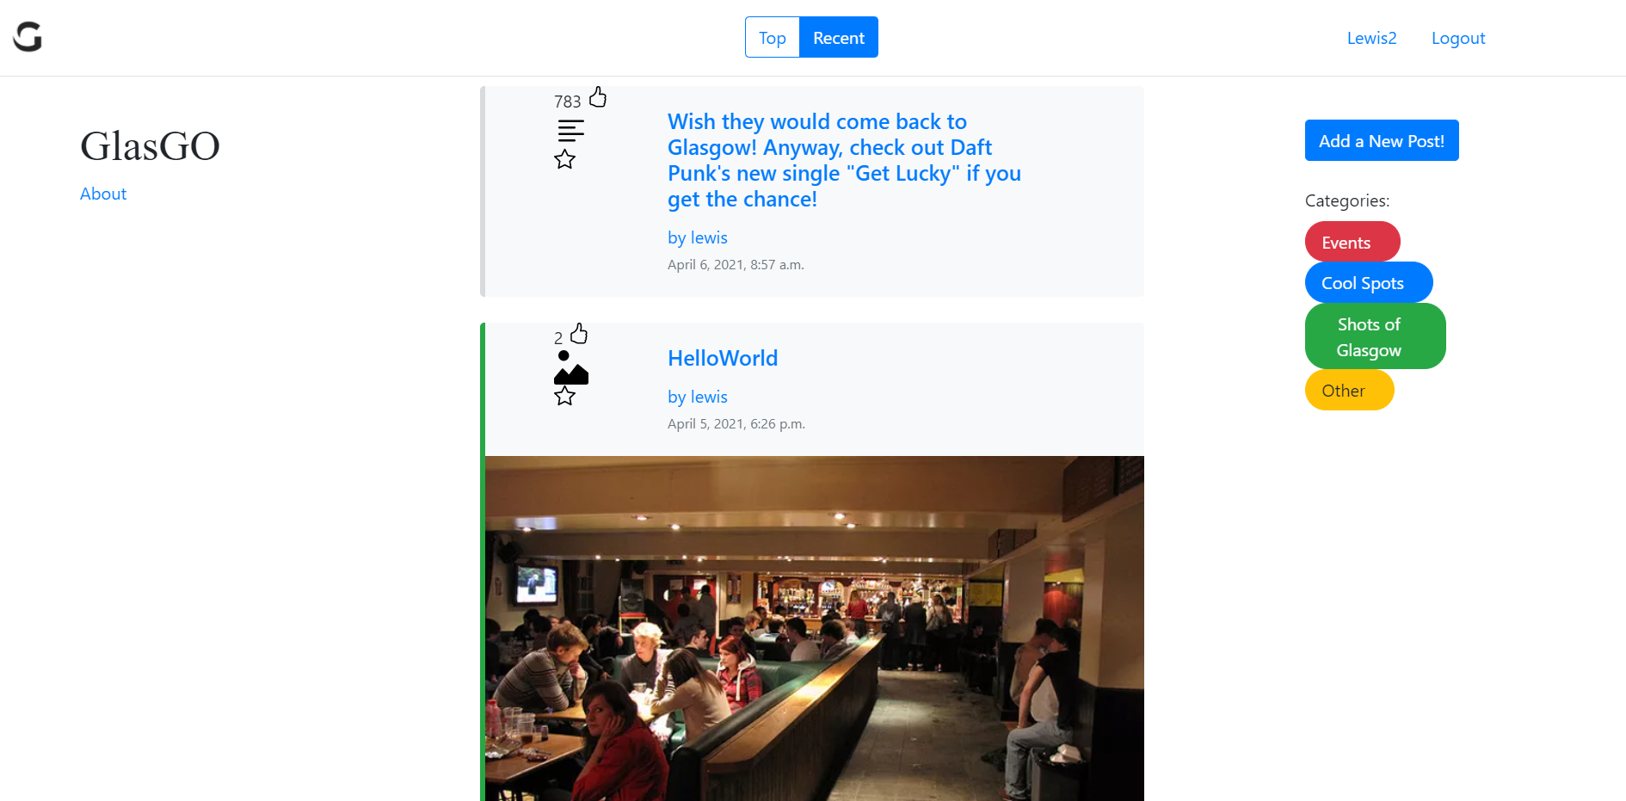

Slide 6
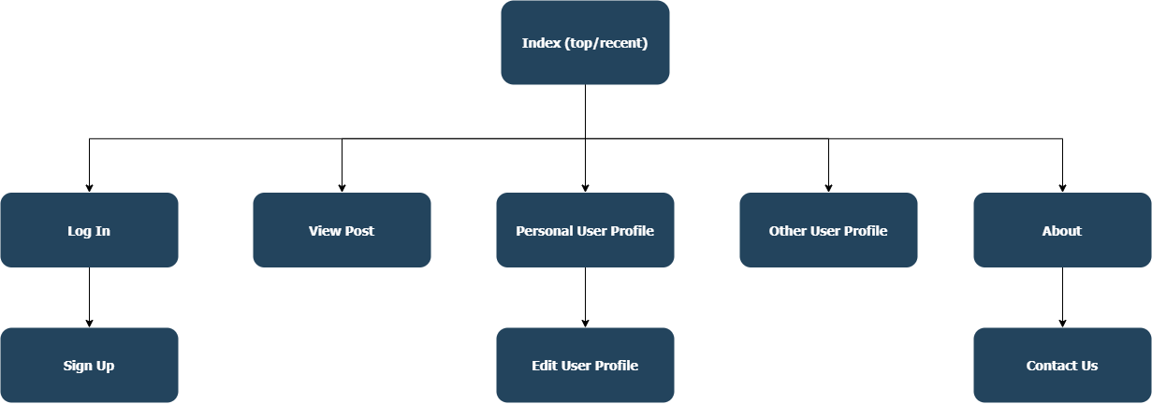
Site Map

Slide 7
Team Contributions
Design Specs + Presentation submission:
Karlis: slides wrap-up, ER diagram, site map, wireframes
Liu: ER diagram, submission documents
Simona: slides framework and wrap-up, ER diagram, Personas
Lewis: GlasGO overview, URLs, presentation video recording
Web App Development:
Karlis: app framework, forms, templates (with Bootstrap 4), authentication, models, jQuery, CSS, population script
Liu: user authentication, views, models, ajax, population script, README.md
Simona: views, models, ajax, minor templates, URLs, deployment on PythonAnywhere
Lewis: unit tests

Slide 8

Developers
Simona Holúbková
Yanling Liu
Lewis McGlinchey
Kārlis Siders
2483856H
2451921L
2259138M
2467273S

